Slide 1
T1.4 – Industrial Use Cases for Turkish Consortium
UC-TR-01 | Documents of Quality Assurance Department
Description | To create faster and more accurate the forms that are used in quality control progress and trigger related forms (re-work form triggering, revision needed, approved, rejected etc.)
Actors | Quality Managers, Quality Measurement Specialists, Quality Control Personnel, Quality Auditors, Production Crews
Assumptions | Quality control measurement units are standart Rejected and Approved products forms are standart Quality Certification standarts are always applied

Slide 2
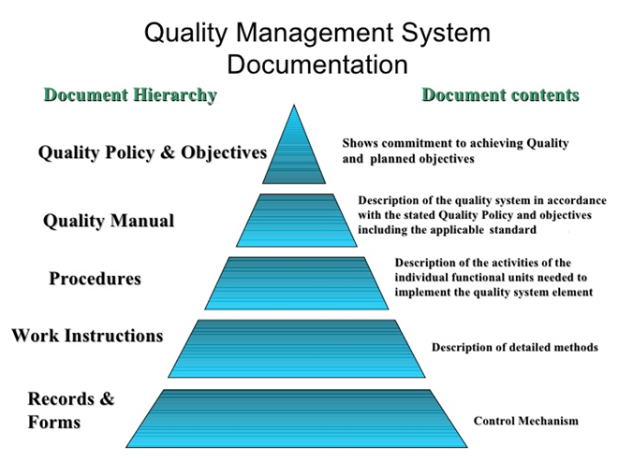
TR-UC-01 Documents of Quality Assurance Department

Slide 3
TR-UC-01 Documents of Quality Assurance Department
What we expect ModelWriter about QDMS:
Quality documents and forms are mostly too generic and similar. However some customers and users would like to customized documents. We would like to develop ModelWriter system could automatically generated QDMS related docs and forms with respect to Quality Test results.
With sharing utility QDMS documents will be send to company managers, quality department authorised personnel, related customers’ responsibles and suppliers2 responsibles if manufactured part comes from subcontractor.
What we have done until today about QDMS use case:
Customer segmentation done, customer database and data relations are ready for ModelWriter
Suppliers information are acqisied from database, ready to integrate ModelWriter system
Models of Quality Documents and forms have been completed

Slide 4
T1.4 – Industrial Use Cases for Turkish Consortium
UC-TR-02 | Non-Disclosure Agreements
Version | V1.0.0 dated 15-Nov-2014
Description | Non-Disclosure Agreement (NDA), also known as a confidentiality agreement (CA), confidential disclosure agreement (CDA), proprietary information agreement (PIA), or secrecy agreement (SA), is a legal contract between at least two parties that outlines confidential material, knowledge, or information that the parties wish to share with one another for certain purposes, but wish to restrict access to or by third parties. It is a contract through which the parties agree not to disclose information covered by the agreement. An NDA creates a confidential relationship between the parties to protect any type of confidential and proprietary information or trade secrets. As such, an NDA protects nonpublic business information. NDAs are commonly signed when two companies, individuals, or other entities (such as partnerships, societies, etc.) are considering doing business and need to understand the processes used in each other's business for the purpose of evaluating the potential business relationship
Actors | Responsible/Authorised personnel in both parties.

Slide 5
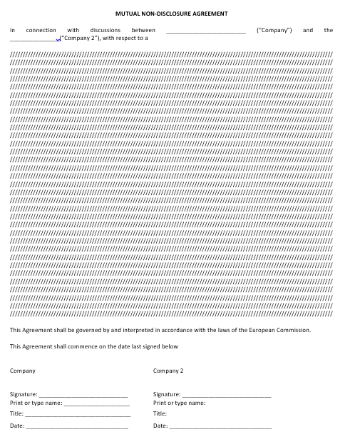
TR-UC-02 Non-Disclosure Agreements
Company Information of Parties who sign NDA
Items of NDA with respect to contracted project(s) between parties, project related information such date of document, content of project etc.
Responsible names and their signatures from each party

Slide 6
TR-UC-02 Non-Disclosure Agreements
What we expect ModelWriter about NDAs:
Automatically captured parties information, main company and customer information
Automatically filled names and signatures (if digital/electronical signatures)
Automaticaly generate items according to given project ID
With sharing utility ModelWriter will be able to send finalised and revised NDA to related parties and their contracted lawyers to review.
What we have done until today about NDA use case:
Company information acquisition from database is done
Customer segmentations completed ready to integrate and acquisite their data to ModelWriter
Projects database relations have been built, ready to integrate ModelWriter engine

